Slide 1

DATASET
Movies_Metadata
Link: https://www.kaggle.com/karrrimba/movie-metadatacsv

Slide 2
Data Set Description
Description: This dataset gives the information about the various factors of movies.
The dataset contains information about the name of different Movies, Director names, Budget, IMDB rating, Countries, Gross, etc.
There are in total 5100 observations with 28 variables.

Slide 3
Dataset Overview
After observing the dataset, there are some major factors such as movie titles, Gross, Budget and country from which we can extract insights and meaningful patterns from the data.
To get more knowledge about the data we have created some questions from which we can get the clear relationships among different parameters.

Slide 4
Questions for Visualization
Top 10 countries producing longest movies.
Top 10 countries producing movies on basis of IMDB Scores.
TOP 20 Movies Earning the most followed by Top 20 movies with Topmost Profit.
TOP 20 Genres Yearly with Movie Facebook Likes
TOP 20 Directors with Highest Number of Movies
TOP 15 Directors with the most number of movies.

Slide 5
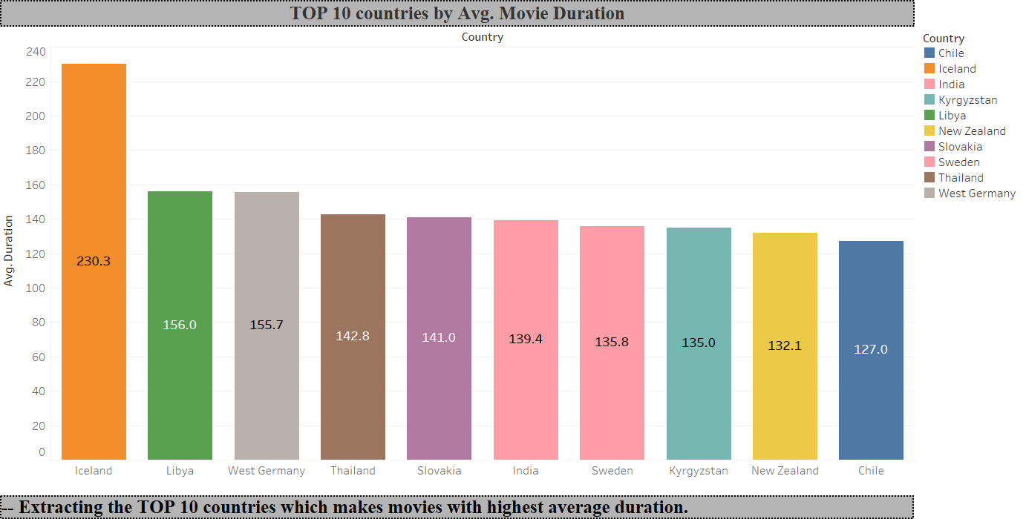
Q.1 Visualization
Notes:
-- The above graph depicts top 10 countries based on their movie production’s duration.
-- It can be visualized that Avg. longest movies are being produced by Iceland which is nearly 4 hours.
-- There is a huge dip in Avg. movie duration with around 1 hour and then not much variation are seen in next few countries.

Slide 6
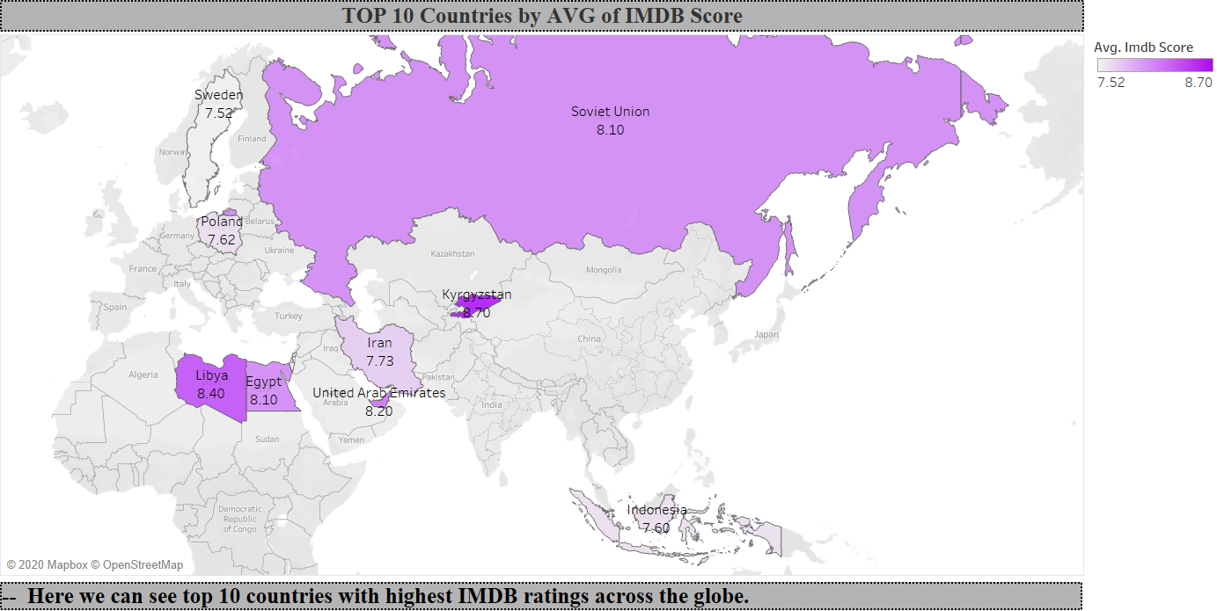
Q.2 Visualization
Notes:
-- The map visualizes top 10 countries producing top rated movies.
-- It can be clearly observed that Kyrgyzstan produces movies with topmost ratings followed by Libya.
-- It can also be seen that even though there are only 10 countries the Avg. IMDB score sees significant dip.

Slide 7
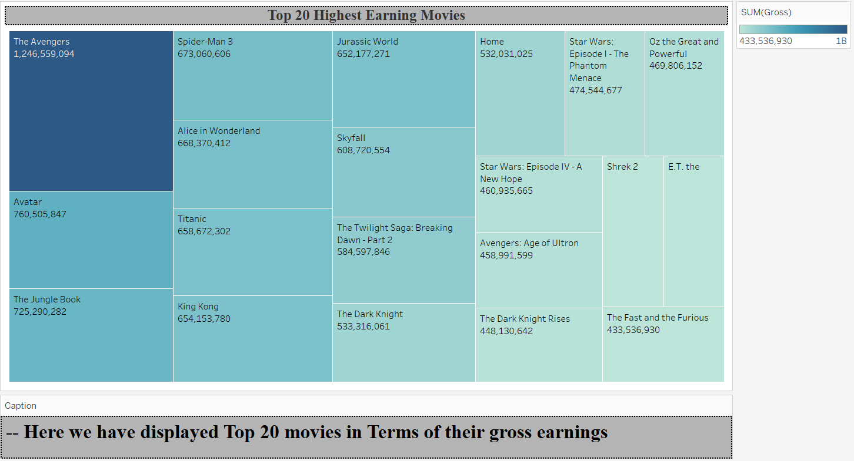
Q.3 Visualization
Notes:
-- The above chart shows Top 10 movies with highest gross earnings.
-- It can clearly concluded that The Avengers is the movie that has earned the most followed by Avatar with a significant difference of 5B (approximately).

Slide 8
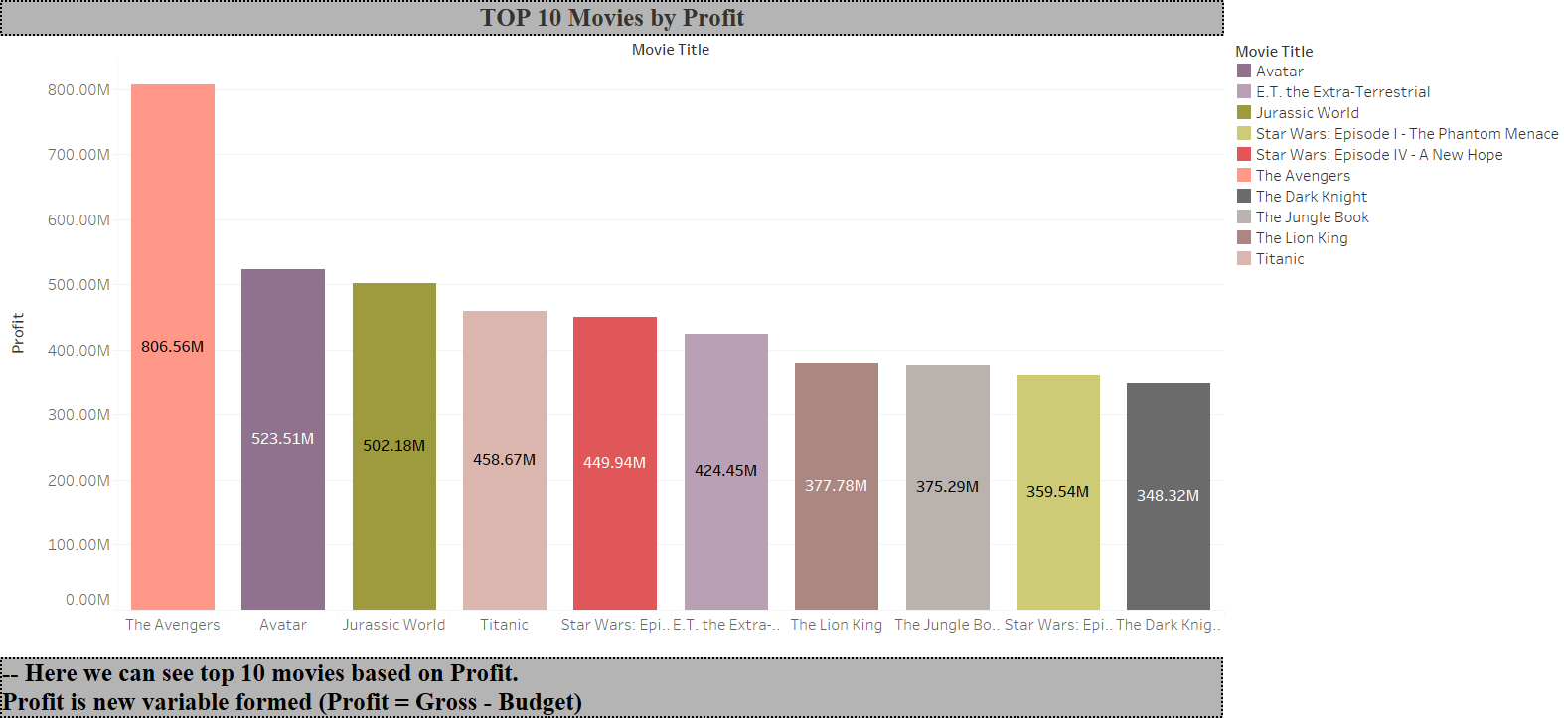
Q.3-2 Visualization
Notes:
-- For this graph we created a new variable profit, where Profit = Gross – Budget.
-- Further, we saw top 10 movies with highest profit.
-- It can be seen that the first 2 movies ‘The Avengers’ and ‘Avtar’ had same place as gross and then the pattern changes.

Slide 9
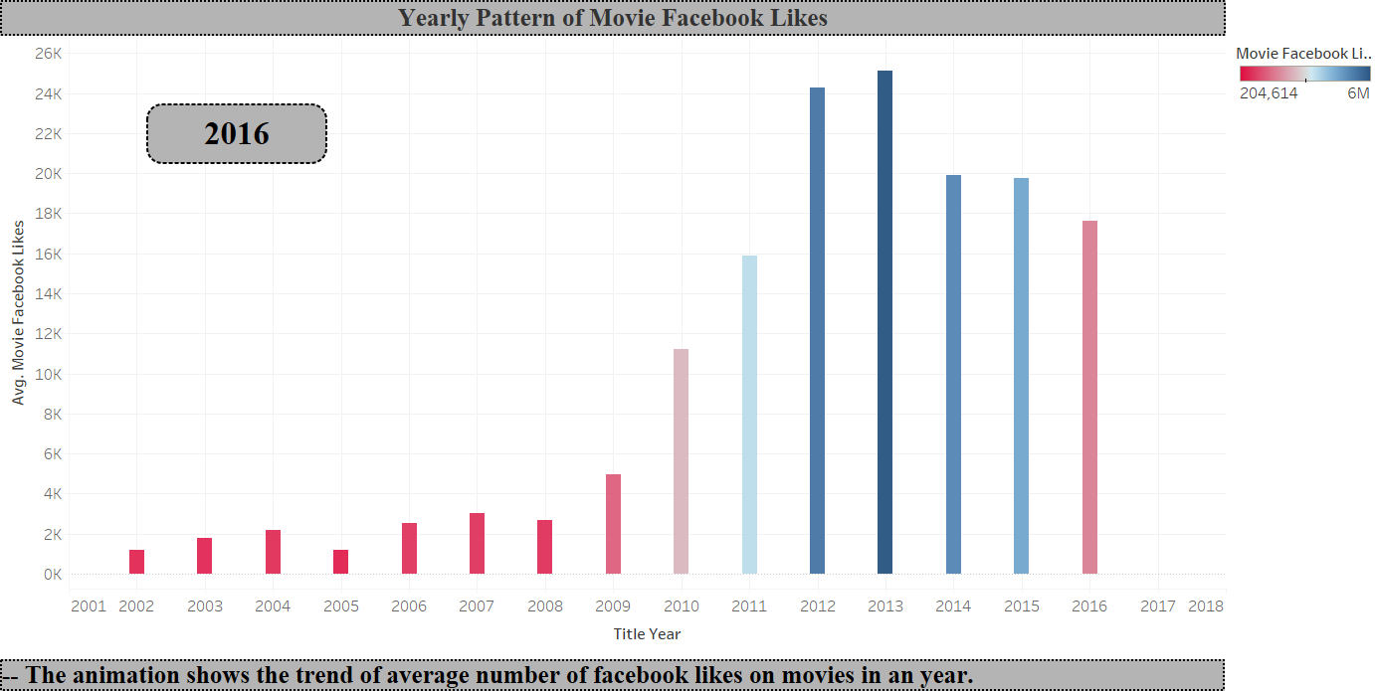
Q.4 Visualization
Notes:
-- The above graph is an animated visualization which shows you the pattern of social media’s impact on movies over the years.
-- In early 2000’s due to lack of internet sources, the movies got low likes on their facebook pages.
-- Further in early 2010’s the craze of facebook emerged and it saw a huge raise in their popularity on social media.

Slide 10
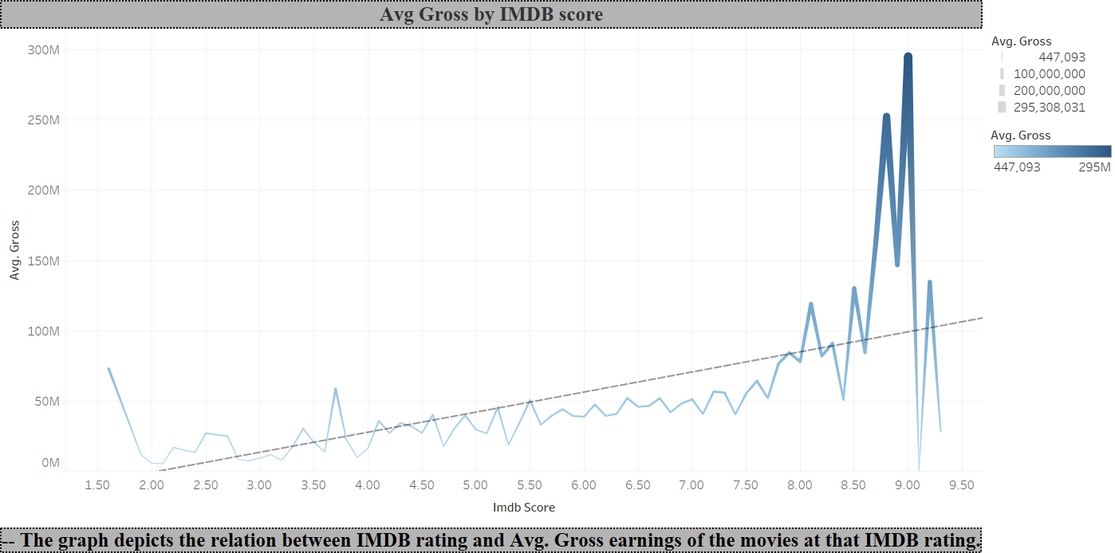
Q.5 Visualization
Notes:
-- This graph shows impact of Avg. gross earnings on the basis of IMDB ratings.
-- It can be seen that higher the IMDB rating higher the gross for the IMDB range 2 to 9.
-- IMDB less than 2 and greater than 9 can be considered as exception and can be neglected.

Slide 11
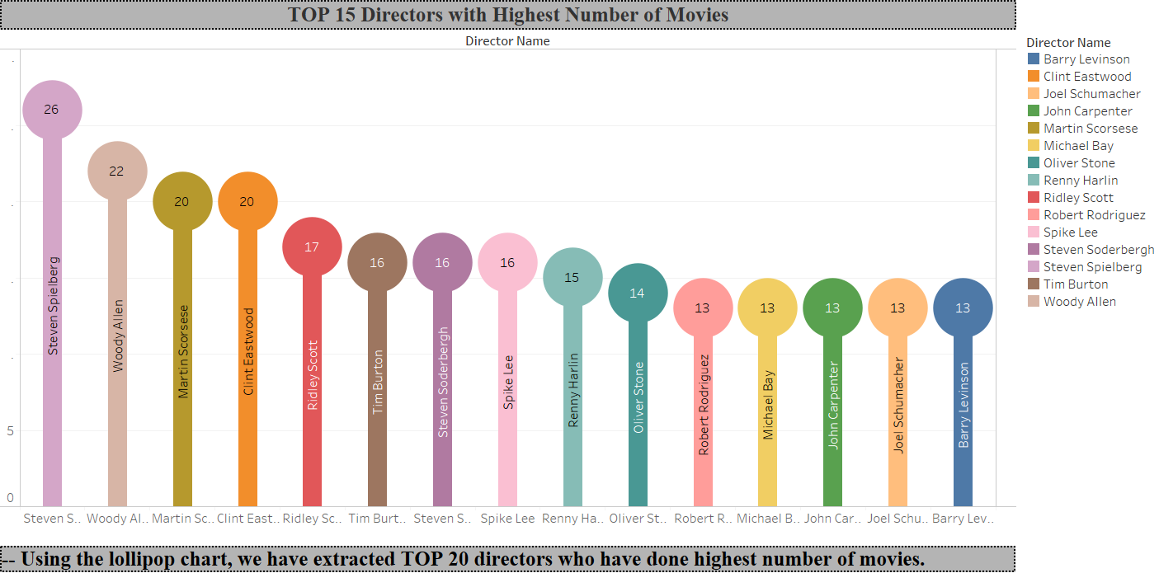
Q.6 Visualization
Notes:
-- The lollipop chart shows directors with most number of movies.
-- The director with most number of movies is Steven Spielberg which has made famous movies like Jurrasic Park, Lincoln, etc. followed by Woody Allen.

Slide 12
Story Part
In the story we would like to view various impacts on the profit of movies.
For that we would compare on basis of Gross, Budget and IMDB.
For the story explanation we have considered using a box plot, a bar chart and two line charts to view the trend.

Slide 13
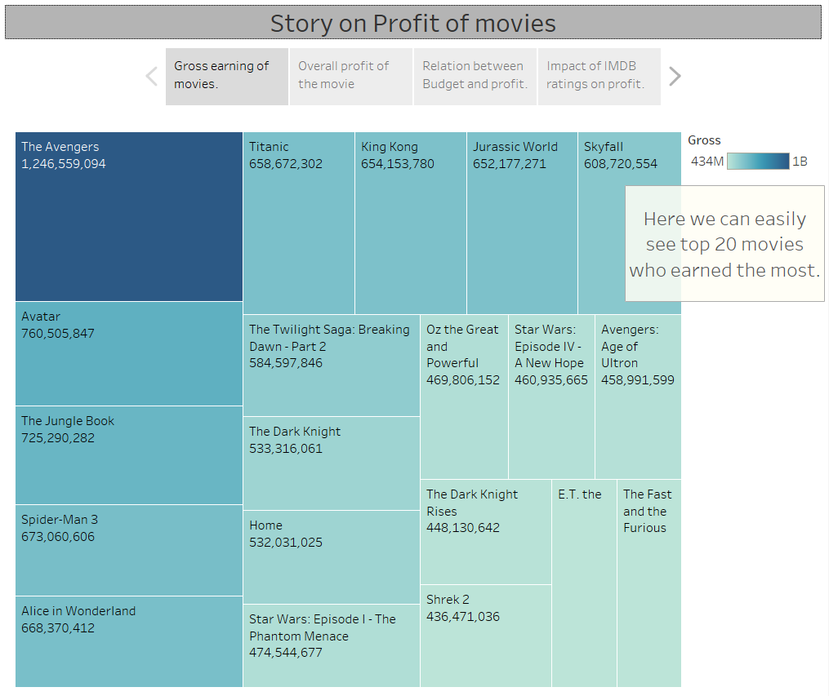
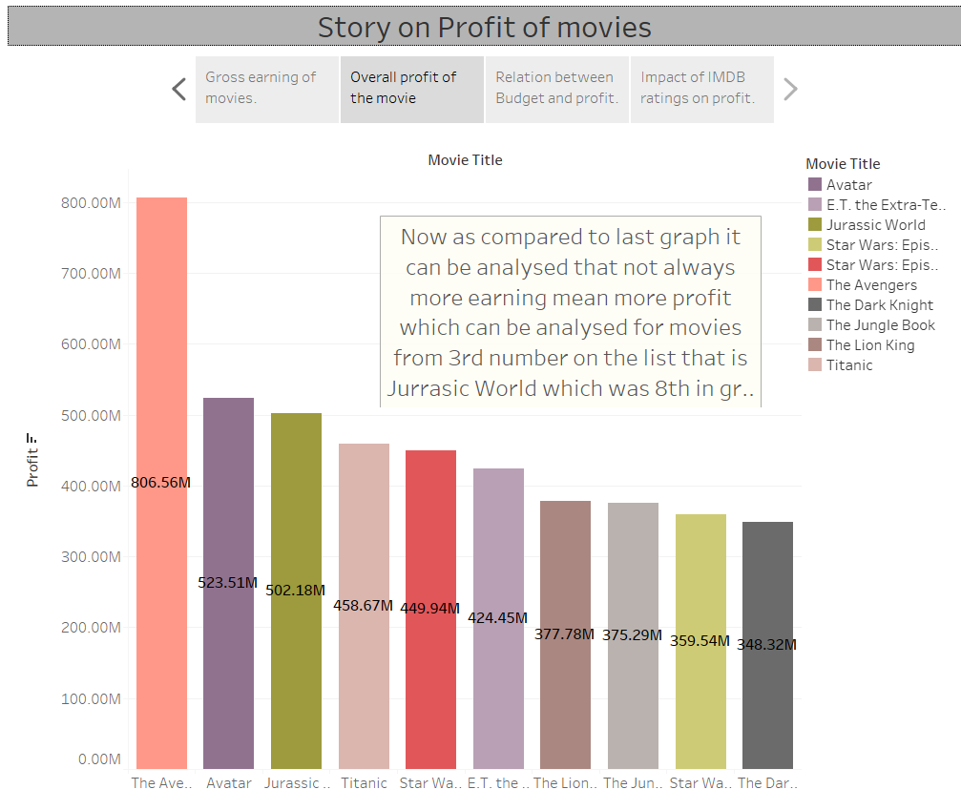

Slide 14
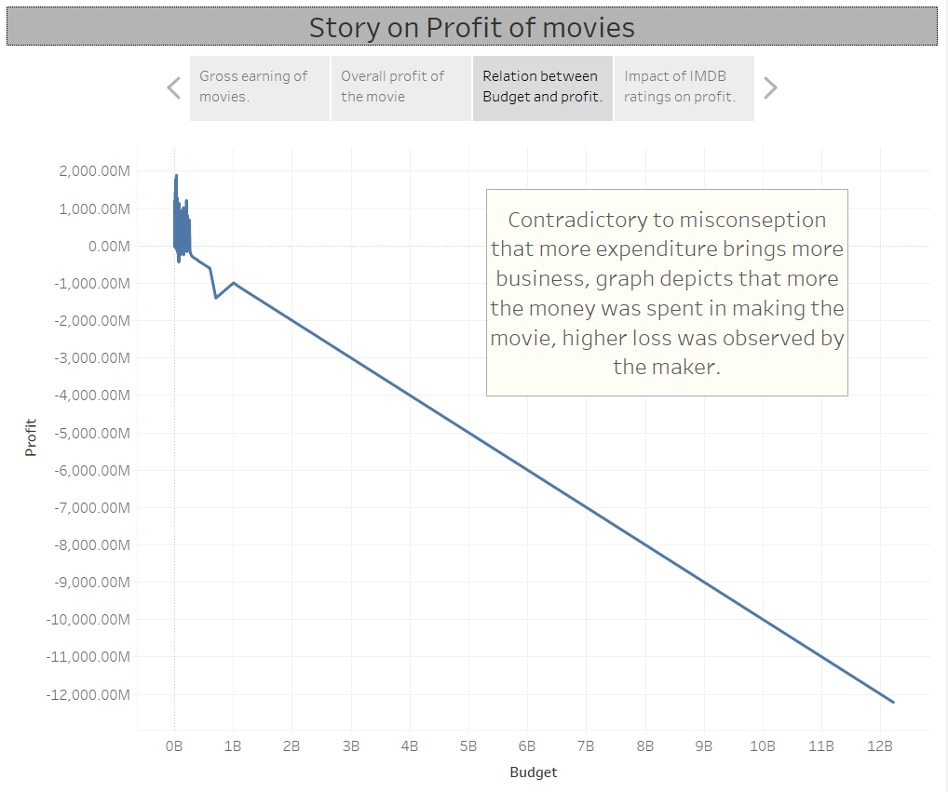
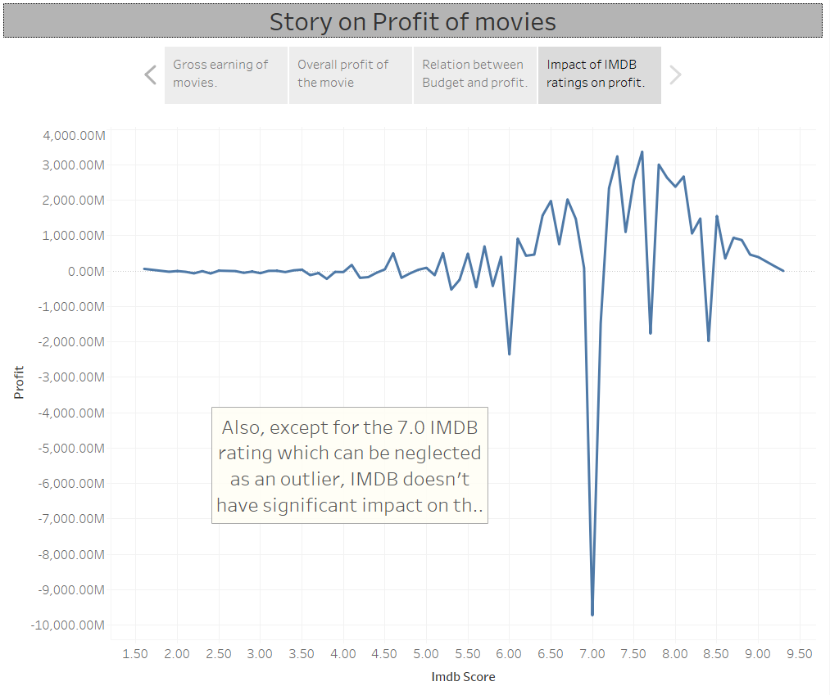

Slide 15

Thank you!

